Slide 1
Unit-3 Data Oriented Analysis & Design

Slide 2
Modelling
A model is an abstraction of something for the purpose of understanding it before building it.
Both physical models and computer models are usually cheaper than building a complete system.
Communication with customers
Visualization
Reduction of complexity
Abstract view of the system
Notes:
Later on models are translated into implementation.
Advantage in documentation
Product designers build models to show their customers, Visualization: advertisement, Reduction in complexity: to understand system which are complex
Abstraction is incomplete, inaccurate, but captures crucial aspects of a system, it limits the universe so we can understand.
Don’t search absolute truth, but for adequecy for some purpose.

Slide 3

Class Model
A class describe a group of objects with the same properties.
Objects in a class have the same attributes and behaviour.
Class diagram provides a graphical notation for modelling classes and their relationships.

Slide 4
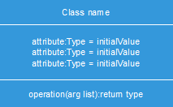
Attributes and Operations
An operation is a function or procedure that may be applied to or by objects in a class.
A method is the implementation of an operation for a class.

Slide 5
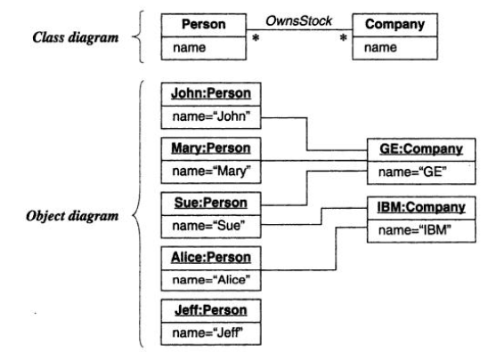
Links and Associations

Slide 6

Multiplicity
Multiplicity specifies the number of instances of one class that may relate to single instance of an associated class.
Ex: 1; 1…* ; 3…5 ; 0…1 ; *
Multiplicity is constraint on cardinality.

Slide 7
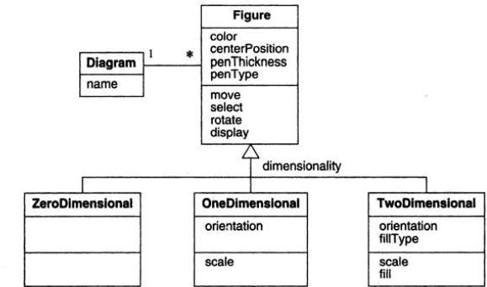
Generalization
Relationship between superclass and subclasses.

Slide 8
Visibility
Visibility refers to the ability of a method to reference a feature from another class.
It has possible values of public (+), private (-), protected (#).

Slide 9
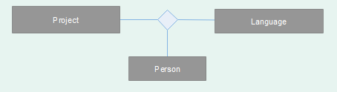
N-ary associations

Slide 10
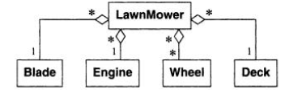
Aggregation
Aggregation is string form of association in which an aggregate object is made of constituent parts.
Part-whole relationship
Aggregation vs. Association

Slide 11
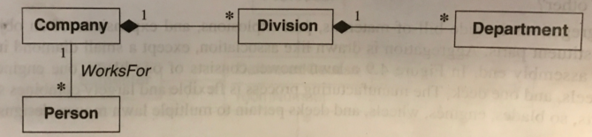
Composition
Composition is a form of aggregation with two additional constraints:
1. A constituent part can belong to at most one assembly.
2. It has a coincident lifetime with the whole assembly.

Slide 12
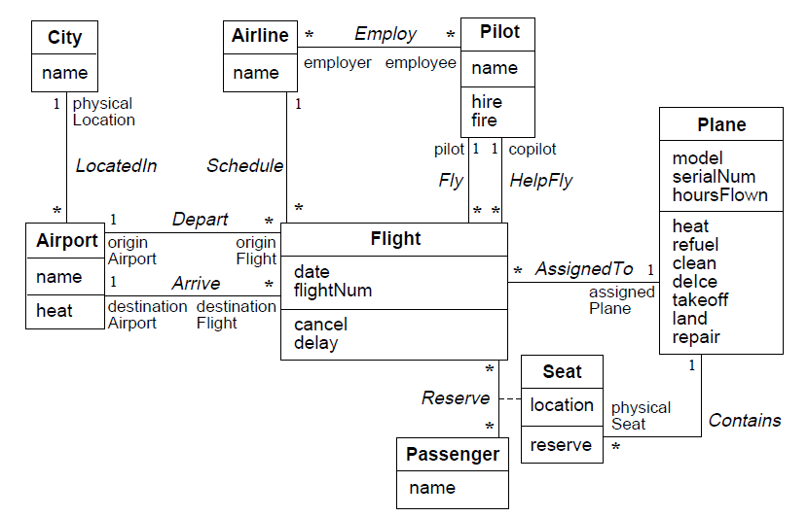
Example Airline System

Slide 13
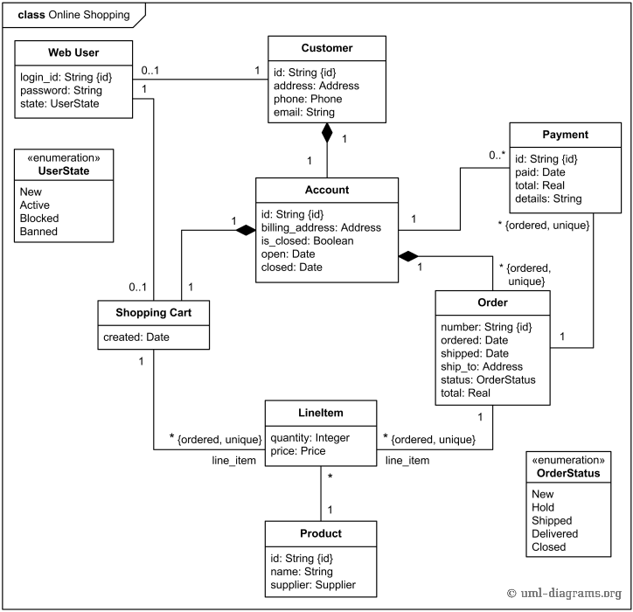

Slide 14
Guidelines for class diagrams
Try to avoid n-ary associations.
Restrict generalization upto 4-5 levels.
Don’t get confused between aggregation and composition.
Associations are bidirectional, without specifying arrows.
Try to use minimal number of classes, avoid redundancy.

Slide 15
Interaction Modelling
Class model describes the objects in a system and their relationships, and the interaction model describes how the objects interact.
Interactions can be modelled at different levels of abstractions.
At high level, use cases describe how a system interacts with outside actors.
Sequence diagram provides more detail and show the messages exchanged among a set of objects over time.
Activity diagram provides further detail and show the flow of control among the steps of a computation.

Slide 16
Use Case Model
Actor: object or set of objects that communicates directly with the system.
Use case: functionality that a system can provide by interacting with actors.

Slide 17
Conti…
UML use case diagrams are ideal for:
Representing the goals of system-user interactions
Defining and organizing functional requirements in a system
Specifying the context and requirements of a system
Modeling the basic flow of events in a use case

Slide 18
Use case diagram symbols and notation
Use cases: Horizontally shaped ovals that represent the different uses that a user might have.
Actors: Stick figures that represent the people actually employing the use cases.
Associations: A line between actors and use cases. In complex diagrams, it is important to know which actors are associated with which use cases.
System boundary boxes: A box that sets a system scope to use cases. All use cases outside the box would be considered outside the scope of that system. For example, Psycho Killer is outside the scope of occupations in the chainsaw example found below.
Packages: A UML shape that allows you to put different elements into groups. Just as with component diagrams, these groupings are represented as file folders.

Slide 19
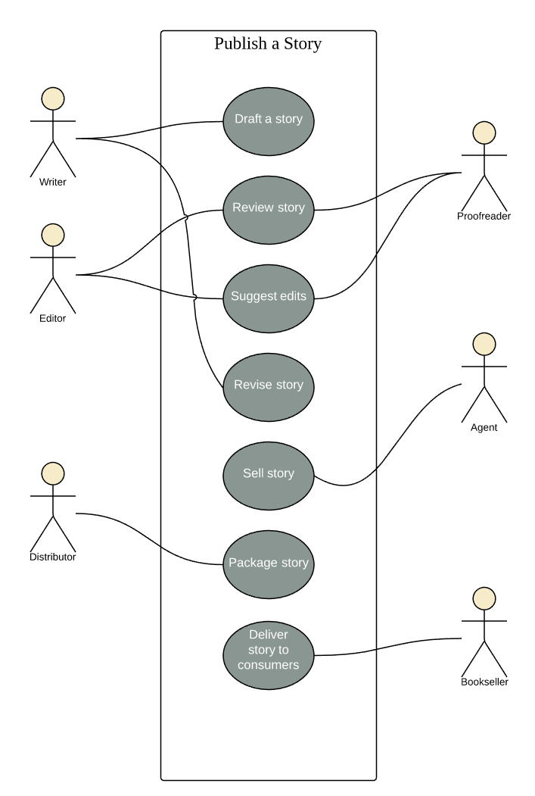

Slide 20
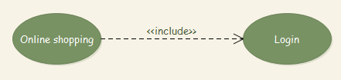
Use Case Relationships
Include relationship

Slide 21

Exclude relationship

Slide 22
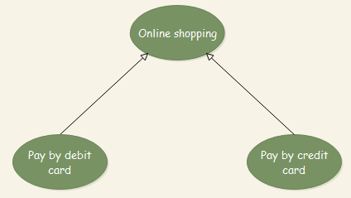
Generalization relationship

Slide 23
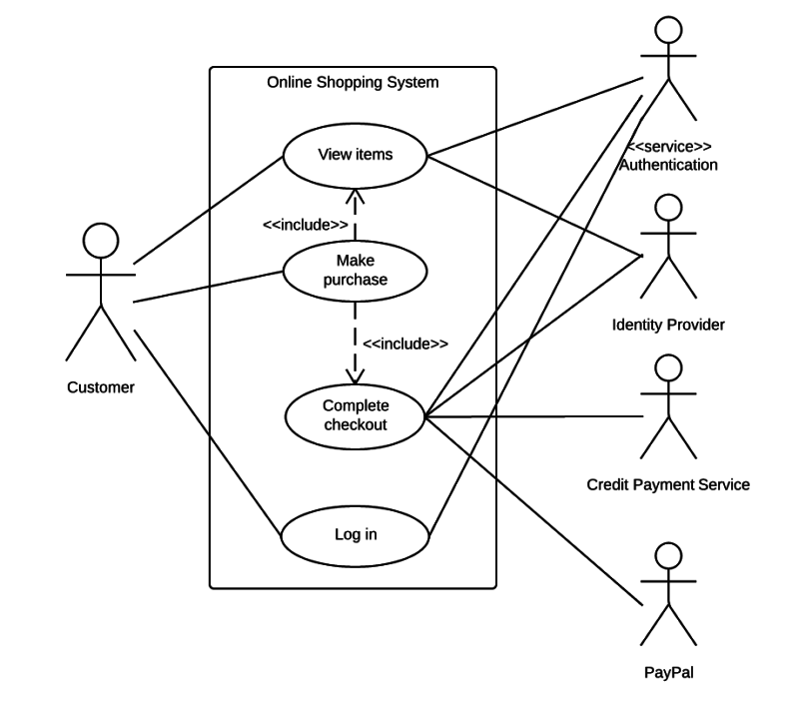

Slide 24
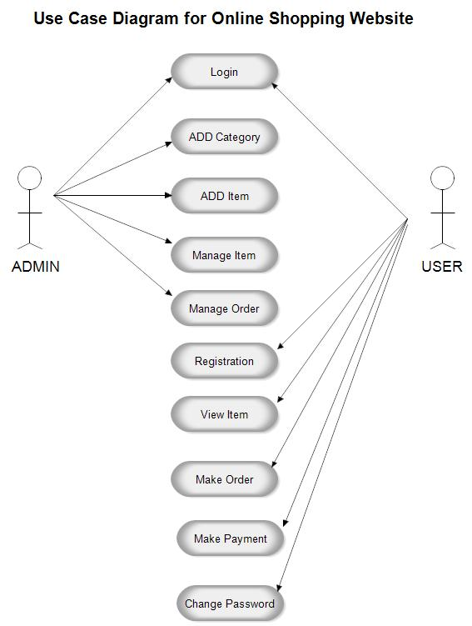

Slide 25
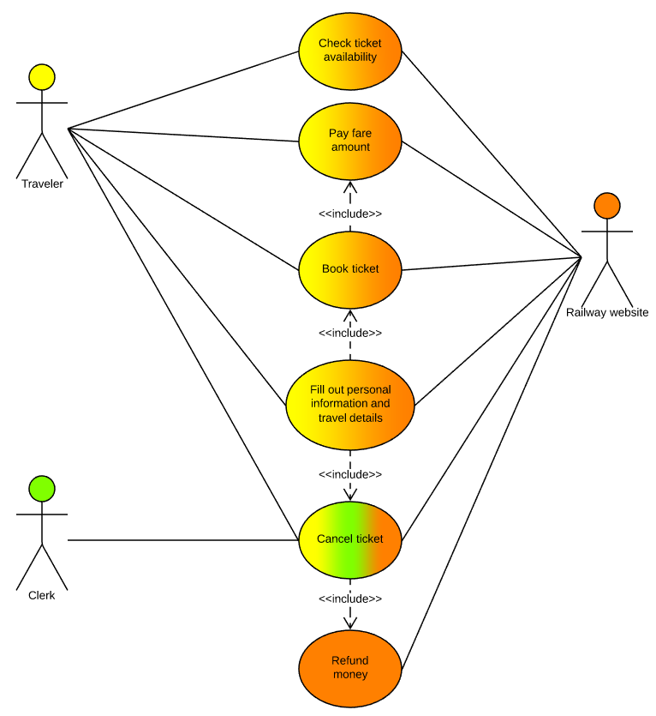

Slide 26
Guidelines for use case diagrams
The actors need not be always persons.
Distinct behaviour sequence (exceptions) and error conditions.
Multiple actors can participate in a use case.
Every use case should have at least one actor, and every actor should participate in at least one use case.

Slide 27
Sequence Model
A sequence diagram shows participants in an interaction and the sequence of messages among them.
Components of Sequence Model:
Lifeline
Message
Concurrent signals
Each use case requires one or more sequence diagrams to describe its behaviour.
Each sequence diagram shows a particular behaviour sequence of a use case.

Slide 28
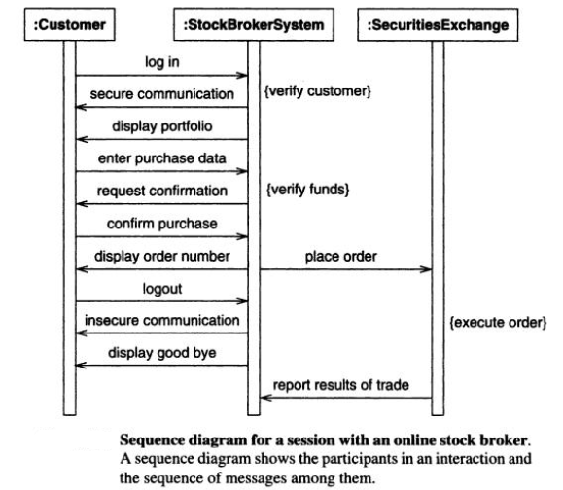

Slide 29
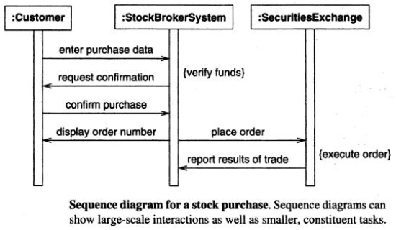

Slide 30
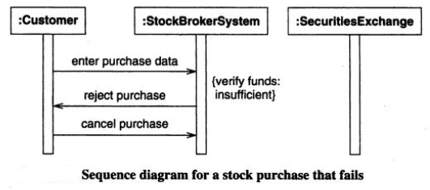

Slide 31
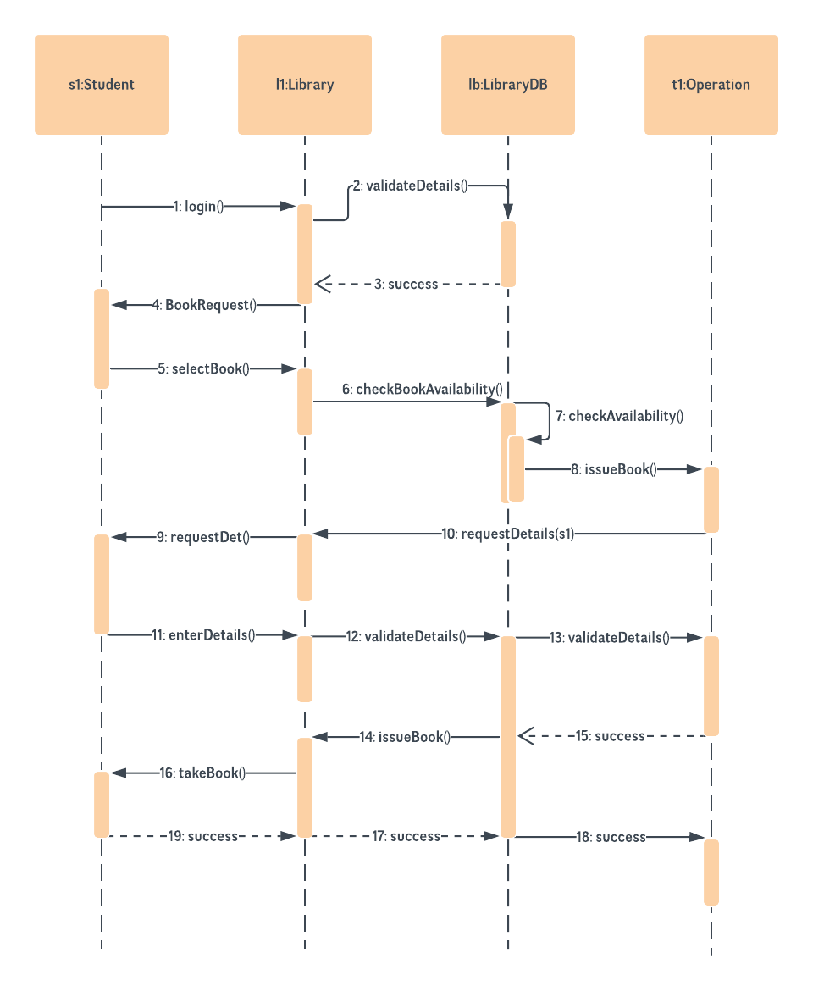

Slide 32
Guidelines for sequence diagrams
Break large interactions into small tasks and prepare a sequence diagram for each of them.
Prepare separate sequence diagram for each error condition.

Slide 33
Activity Model
An activity diagram shows flow of control, similar to a sequence diagram, but focuses on operations rather than objects.
Unlike a flow chart, an activity diagram can show both sequential and concurrent flow of control.
Branches
Initiation and termination
Concurrent activities (fork and merge)

Slide 34
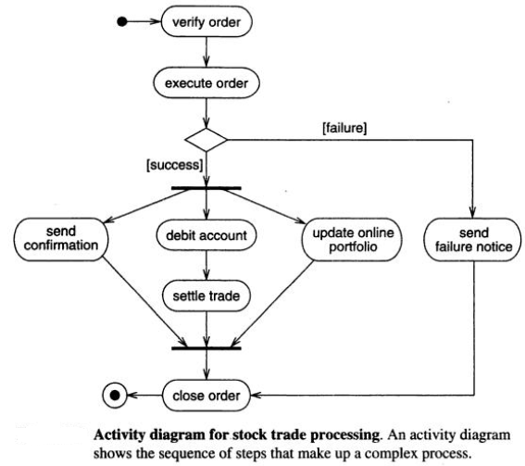

Slide 35
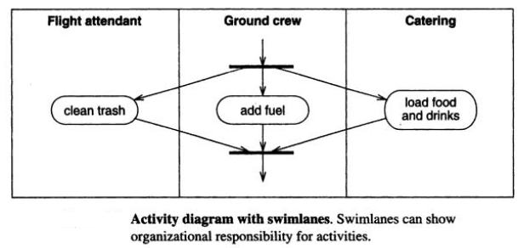

Slide 36
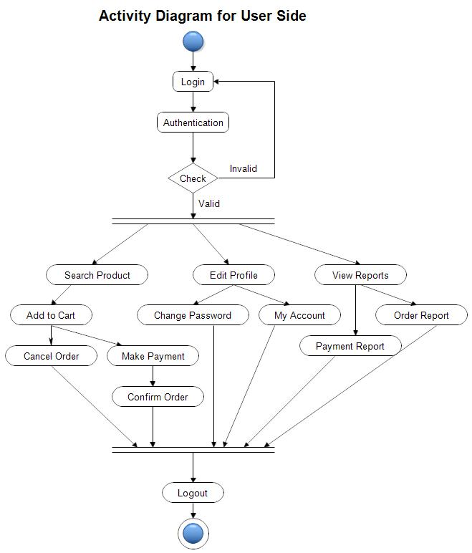

Slide 37
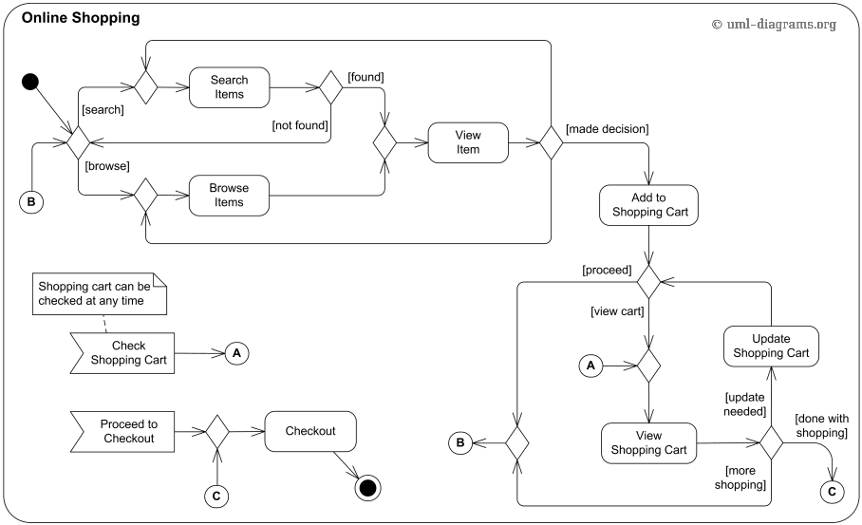

Slide 38
Data objects
It is set of attributes that will be manipulated within the software. It can be a person, organization, device or software product.
Each instance of data object can be identified with the help of unique identifier. E.g. Roll No.
The system cannot perform without accessing to the instances of object. Each object is described by attributes.
It is a collection of attributes that act as an aspect, characteristic, quantity or descriptor of the object.
Object
Attributes
Typical data objects are:-
External Entities (printer etc), Things (repports etc), Occurences (alarm etc), Roles (manager etc), Places (workshops etc), Organizational Units (departments etc), Structures (files etc)

Slide 39
Attributes
Attributes defines properties of data object.
Three types of attributes:
Naming attribute – Used to name an instance of data object.
Descriptive attribute – Used to describe characteristics or features of the data object.
Referential attribute – These are the attributes that are used in making the reference to another instance to another table.

Slide 40
Relationship
It represents connection between data objects.
For example:
Customer and Order are two classes then relationship is:
Customer gives order

Slide 41
E-R Model
The ER model defines the conceptual view of a database.
ER Model is a database modeling technique that generates an abstract diagram or visual representation of a system’s data that can be helpful in designing a relational database. These diagrams are known as entity-relationship diagrams, ER diagrams or ERDs.
It works around real-world entities and the associations among them.
At view level, the ER model is considered a good option for designing databases.

Slide 42
ER Model Concepts
ER model has three main concepts:
Entities(and their entity types and entity sets)
Attributes (simple, composite, multivalued)
Relationships (and their relationship types and relationship sets)

Slide 43
Entity
An entity is an object that exists and is distinguishable from other objects.
Entities are specific objects or things in the real-world that are represented in the database.
Entity may be an object with a physical existence for example student.
Entity may be an object with a conceptual existence for example a company, a job, a university course.

Slide 44
Entity Sets
An entity set is a set of entities of the same type that share the same properties.
The set of all persons who are customers at a given bank can be defines as the entity set customer.
The entity loan might represent the set of all loans to be awarded by a particular bank.

Slide 45
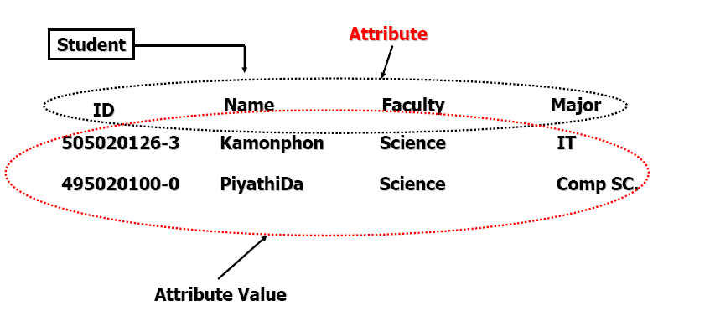
Attribute
An entity is represented by a set of attributes, that is descriptive properties possessed by all members of an entity set.
For example, an STUDENT entity may have the attributes ID, Name, Address, Gender, Birth Date.

Slide 46

Notations
Multivalued Attribute
Entity
Relationship
Weak Entity
Attribute
Derived Attribute
Attribute
Key Attribute

Slide 47
Types of Attributes
Simple or Atomic Attribute
Composite Attribute
Single-Valued Attribute
Multi-valued Attribute
Derived Attribute

Slide 48
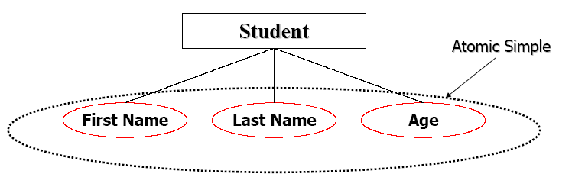
Simple or Atomic Attribute
It cannot be divided into simpler components Example age of an employee.

Slide 49
Composite Attribute
Composite Attributes can be divided into smaller subparts, which represent more basic attributes with independent meanings.
The attribute may be composed of several components. For example: Address(House#, Street, City, State, ZipCode, Country), or Name(FirstName, MiddleName, LastName).
Composition may form a hierarchy where some components are themselves composite.

Slide 50
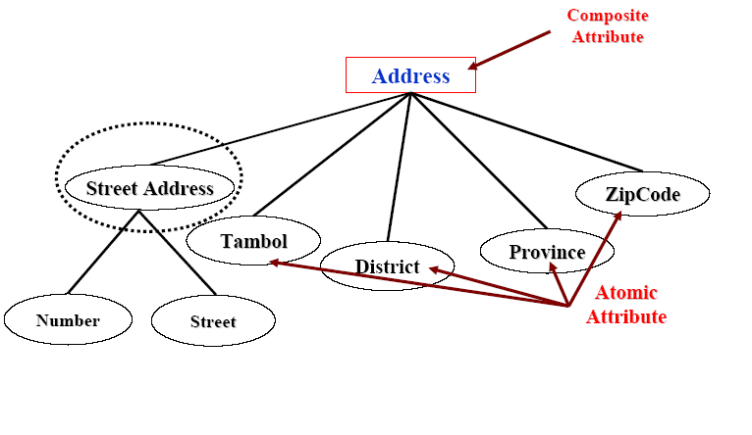
Example

Slide 51
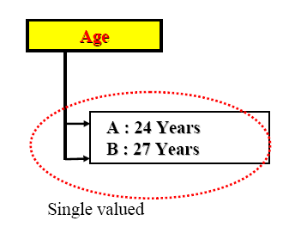
Single Valued Attribute
Single valued attribute has a single value for a particular entity.
E.g.: age of employee. There can be only one value for this.

Slide 52
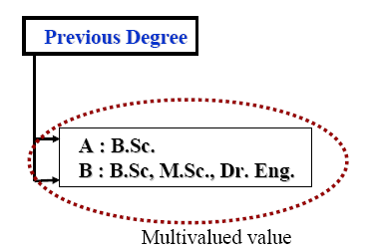
Multi-valued Attribute
Multi-valued attribute has multiple values.
Example: skill set of employee
Another example, employee entity set with the attribute phone number.
An employee may have zero, one or several phone numbers.

Slide 53
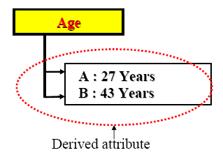
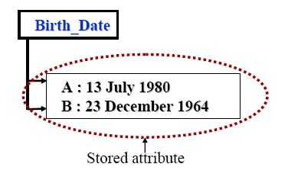
Derived Attribute and Stored Attribute
The value of this type of attribute can be derived from the values of other related attributes or entities.

Slide 54
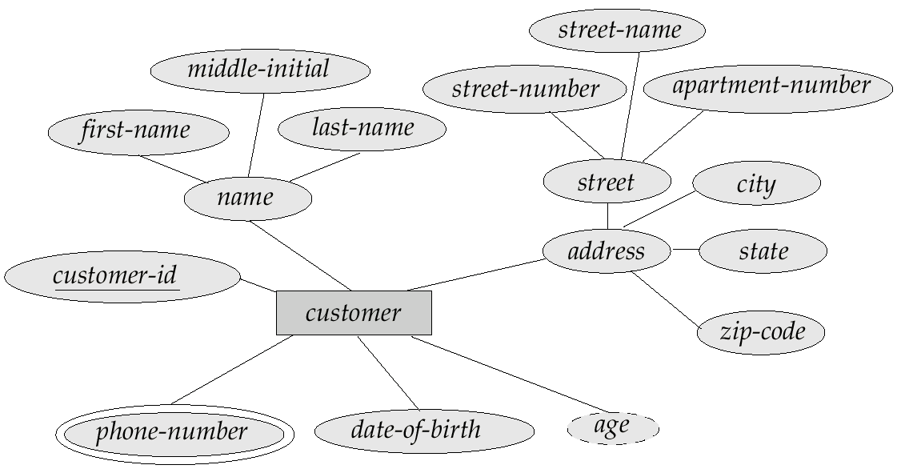
E-R Diagram with Composite, Multi-valued, And Derived Attributes

Slide 55
Mapping Cardinalities
Mapping cardinality or cardinality ratio express the number of entities to which another entity can be associated via a relationship set.
Most useful in describing binary relationship sets, although they can contribute to the description of relationship sets that involve more than two entity sets.
For a binary relationship set R between entity sets A and B, the mapping cardinalities must be one of the following:
One to one
One to many
Many to one
Many to many

Slide 56
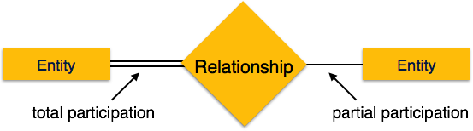
Participation Constraints
Total Participation − Each entity is involved in the relationship. Total participation is represented by double lines. E.g. every loan entity to be related to at least one customer through borrow relationship.
Partial participation − Not all entities are involved in the relationship. Partial participation is represented by single lines. E.g. the participation of customer in the borrower relationship set is partial as not all customer has borrowed loan from bank.

Slide 57
E-R Diagrams
An E-R diagram can express the overall logical structure of a database graphically.
Rectangles represent entity sets.
Diamonds represent relationship sets.
Lines link attributes to entity sets and entity sets to relationship sets.
Ellipses represent attributes
Double ellipses represent multi-valued attributes.
Dashed ellipses denote derived attributes.
Underline indicates primary key attributes.
Double Lines indicate total participation of an entity in a relationship set.
Double rectangles represent weak entity sets.

Slide 58
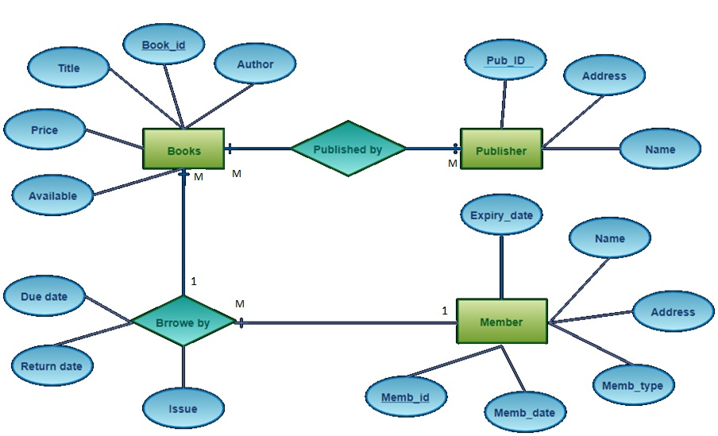
Example 1
Library System

Slide 59
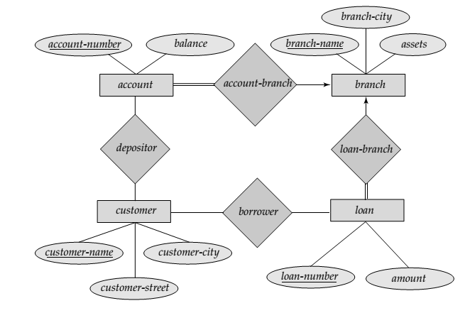
Example 2
Banking System

Slide 60
Guidelines to design E-R Diagram
During requirement elicitation process, the requirements should be collected in such way that we can evolve input, output data objects & external entities for system modelling.
The analysis & customer should be in position to define relationship between data objects.
When connection between data objects is identified the object relationship pair must be established.
For each object relationship pair the cardinality & modality is set.
The attributes of each entity must be defined.
The entity relationship diagram is formalized & reviewed.
All the above steps are repeated until data modelling is complete.

Slide 61
Data Flow Model
The data flow diagram depict the information flow & transforms that are applied on the data as it moves from input & output.
The data flow diagrams are used to represent the system at any level of abstraction.
The DFD can be partitioned into levels that represent increase in information flow & detailed functionality.
A level 0 DFD is called as ‘fundamental system model’ or ‘context model’ representing the entire system.
Each process shown in level 1 represents the sub functions of overall system.
The number of levels in DFD can be increased until every process represents the basic functionality.
As the number of levels gets increased in the DFD, information flow gets refined.

Slide 62
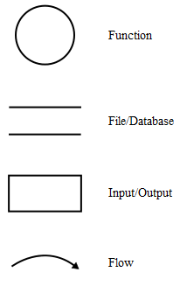
Notations
Process
Data Store
External Entity
Flow of Data

Slide 63
Guidelines to design DFD
Level 0 DFD i.e. context level DFD should depict the system as a single bubble(process).
Primary input & output should be carefully identified.
While doing the refinement isolate process, data objects & data stores to represent the next level.
All the processes & arrows should be appropriately named.
One process at a time should be refined.
Information flow continuity must be maintained from level to level.

Slide 64
Rules for designing DFD
No process can have only outputs or inputs. The process have both inputs and outputs.
The verb phrases in the problem description can be identified as processes in the system.
There should not be a direct flow between data stores and external entity. This flow should go through a process.
Data store labels should be noun phrases from problem description.
No data should move directly between external entities.
Generally source and sink labels are noun phrases.
Interactions between external entities is outside scope of the system and therefore not represented in DFD.
Data flow from process to a data store is managed (U/I/D).
Data flow from data store to process is for retrieving using information.
Data flow labels are noun phrases from problem description.

Slide 65
Process Decomposition
1.0
Sale
1.1
Record Order
1.2
Receive Payment
2.0
Production
2.1
Serve Product
2.2
Produce Product
2.3
Store
Product
0.0
Lemonade System
3.0
Procure-ment
3.1
Produce Purchase Order
3.2
Receive Items
3.3
Pay Vendor
4.0
Payroll
4.1
Record Time Worked
4.2
Calculate Payroll
4.3
Pay Employee
Context Level (Level 0)
Level 1
Level 2

Slide 66
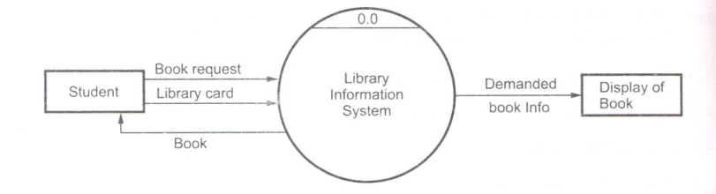
Example (Library System DFD)
Fig: Level - 0 Context Level DFD

Slide 67
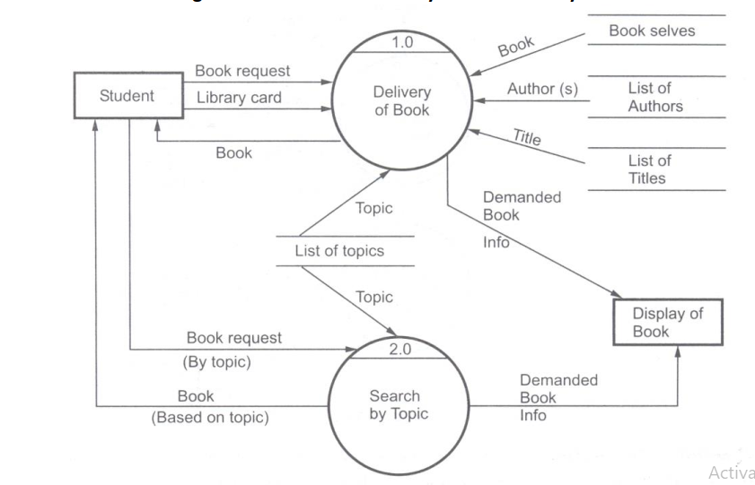
Continued…
Fig: Level - 1 DFD

Slide 68
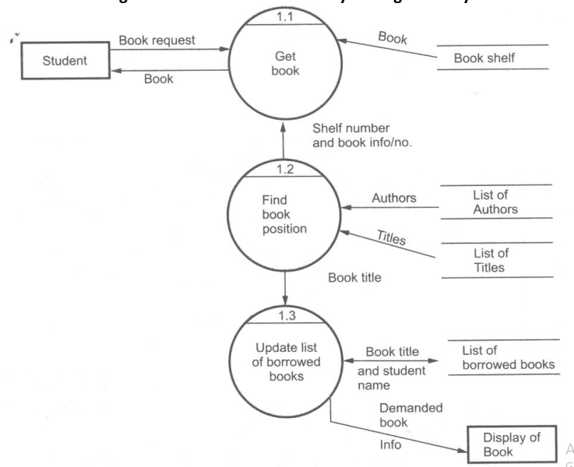
Continued…
Fig: Level - 2 DFD

Slide 69
Control Flow Model (CFD)
The CFD shows the same processes as in DFD but rather than showing data flow they show control flows.
CFD show how events flow among processes. It also shows how external events activate the processes.
The dashed arrow is used to represent the event.
A solid bar is used to represent the window. This window is used to control the processes used in the DFD based on the event that is passed through the window.
Instead of representing control process directly in the model the specifications are used to represent how processes are controlled.
When a data input is given to the process a data condition should occur to get the control output.
There are two commonly used representation of specification: Control Specification(CSPEC) & Process Specification (PSPEC).

Slide 70
Designing Control Flow Diagrams
There are certain applications which are event driven rather than being data driven. They produce control information rather than producing data. Such applications can be modeled with the control information along with data flow modeling.
A graphical model used to represent the control information along with the data flow model is called control flow model.
Following guidelines are used to draw CFD:
List all sensors that can be read.
List all the interrupt conditions.
List all the data conditions.
List all the switches actuated by the operator.
Use noun/verb parsing techniques to identify control information.
Describe behaviour of system by identifying the states. Define the transition between the states.
Avoid common errors while specifying the control.

Slide 71
State(Behavioural) Model
There are two types of diagrams in UML :
Structure Diagrams – Used to model the static structure of a system, for example- class diagram, object diagram etc.
Behavior diagram – Used to model the dynamic change in the system over time. They are used to model and construct the functionality of a system. for example- Interaction diagrams and State diagrams.
A state diagram is used to represent the condition of the system or part of the system at finite instances of time. It’s a behavioral diagram and it represents the behavior using finite state transitions. State diagrams are also referred to as State machines, state transition diagram and State-chart Diagrams.
State diagram is used to model the dynamic behavior of a class in response to time and changing external stimuli.

Slide 72


Basic components of a state chart diagram
Initial state – We use a black filled circle represent the initial state of a System or a class.
Transition – We use a solid arrow to represent the transition or change of control from one state to another. The arrow is labelled with the event which causes the change in state.

Slide 73

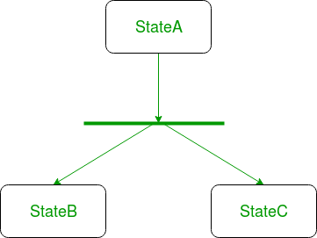
Conti…
State – We use a rounded rectangle to represent a state. A state represents the conditions or circumstances of an object of a class at an instant of time.
Fork – We use a rounded solid rectangular bar to represent a Fork notation with incoming arrow from the parent state and outgoing arrows towards the newly created states. We use the fork notation to represent a state splitting into two or more concurrent states.

Slide 74
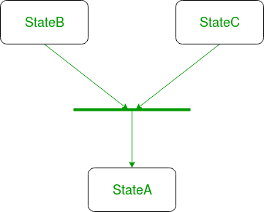
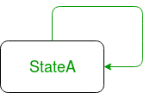
Join – We use a rounded solid rectangular bar to represent a Join notation with incoming arrows from the joining states and outgoing arrow towards the common goal state. We use the join notation when two or more states concurrently converge into one on the occurrence of an event or events.
Self transition – We use a solid arrow pointing back to the state itself to represent a self transition. There might be scenarios when the state of the object does not change upon the occurrence of an event. We use self transitions to represent such cases.

Slide 75
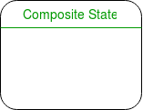

Composite state – We use a rounded rectangle to represent a composite state also. We represent a state with internal activities using a composite state.
Final state – We use a filled circle within a circle notation to represent the final state in a state machine diagram.

Slide 76
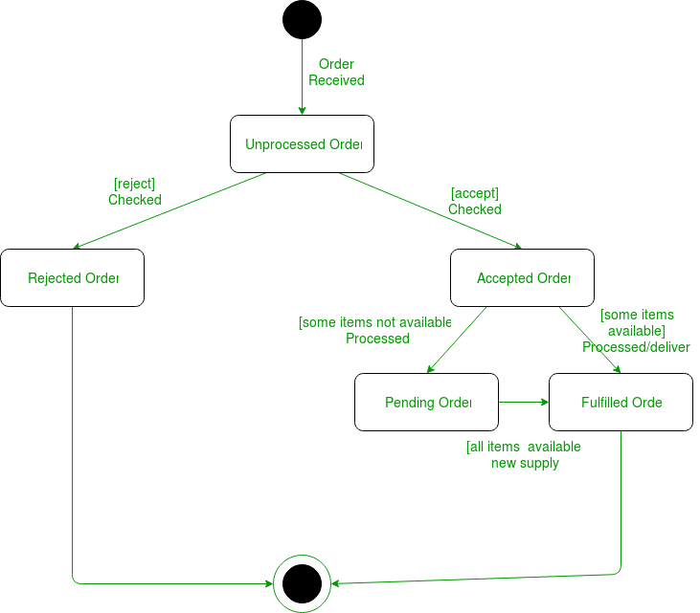
Example

Slide 77
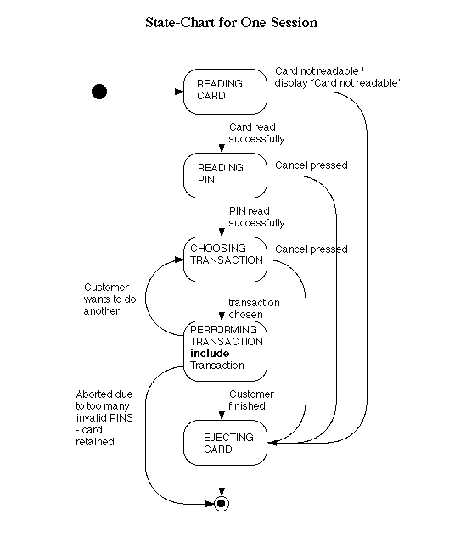

Slide 78
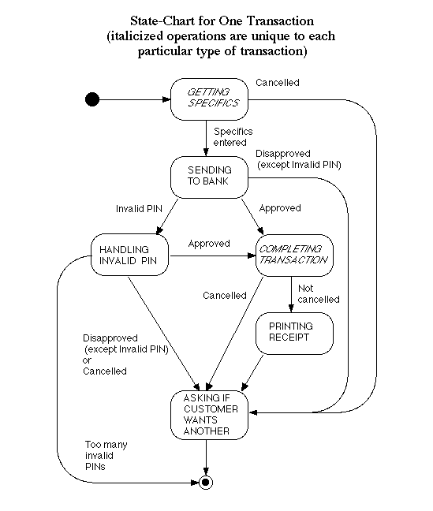

Slide 79
Thank You

